Slide 1
NLP - Sentiment Analysis of “Large Movie Review Dataset” using LSTM network.
Contribution
Team 18
Members
Preeti Singh – 1002013566
Sai Sharath Reddy Koppula – 1002081785
Renu Aakanksha Veesam – 1002113666

Slide 2
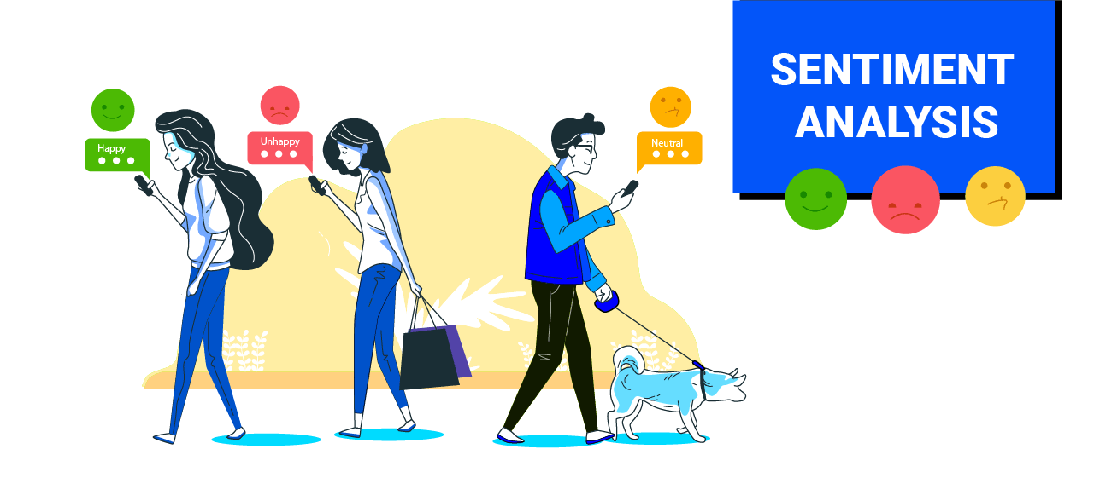
Problem Statement
We are developing a Long Short-Term Memory (LSTM) based Deep Learning model to classify the Stanford’s “Large Movie Review Dataset”.

Slide 3
Dataset
We will be using the “Large Movie Review Dataset” as available in the Stanford’s data repository.
This dataset consists of 50,000 reviews divided into training and test sets:
Training Set Size: 25,000 reviews
Test Set Size: 25,000 reviews
These movie reviews are obtained from the IMDb website and consists of two classes Negative and Positive.
Positive Reviews: 25,000 reviews
Negative Reviews: 25,000 reviews
This is a balanced dataset where both the classes have equal number of samples.

Slide 4
Work Done Till Now
Till Review#2
Downloaded the dataset
Performed Data Preparation and Data Preprocessing steps
Updates after Review#2
Created a baseline LSTM model

Slide 5
Train - Test Split
25,000 samples in the training dataset.
25,000 samples in the testing dataset.

Slide 6
IMDB Dataset in Tensorflow
Ref.: https://www.tensorflow.org/api_docs/python/tf/keras/datasets/imdb/load_data
This is a dataset of 25,000 movies reviews from IMDB, labeled by sentiment (positive/negative).
Reviews have been pre-processed, and each review is encoded as a list of word indexes (integers).
For convenience, words are indexed by overall frequency in the dataset, so that for instance the integer "3" encodes the 3rd most frequent word in the data.

Slide 7
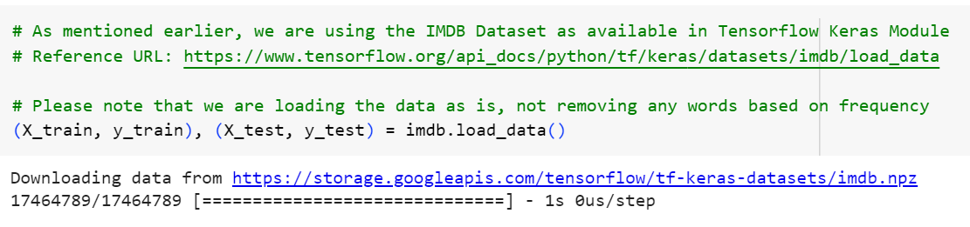
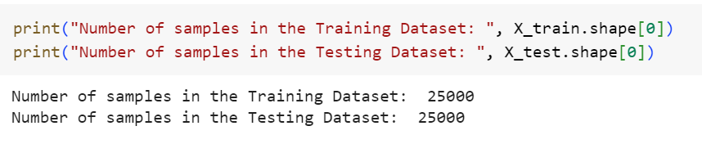
Loading the IMDB Dataset from Tensorflow

Slide 8
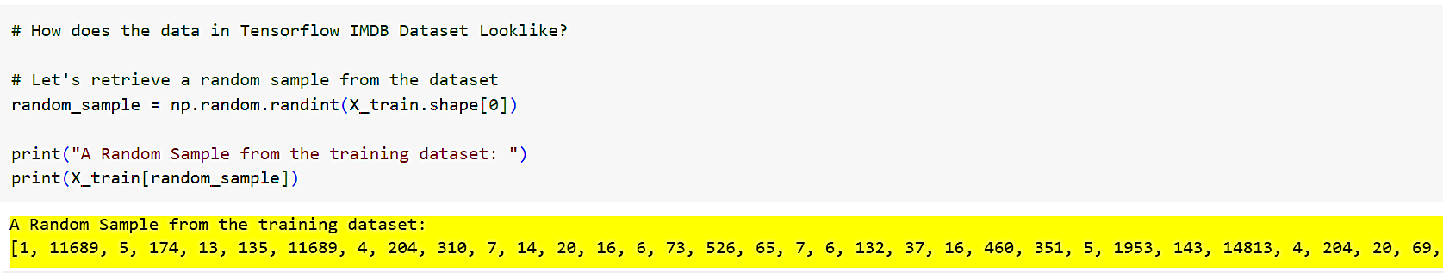
Dataset is Frequency Tokenized

Slide 9
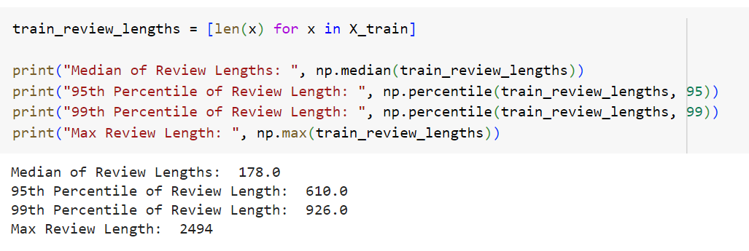
Frequency Analysis of Review Lengths
Here are the median, 95th percentile, 99th percentile and max review length values.
Based on the frequency analysis, we are making all reviews into review of length 610.

Slide 10
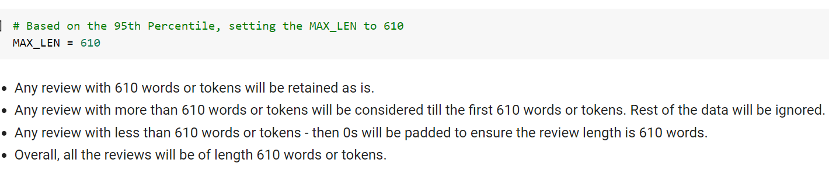
Frequency Analysis of Review Lengths

Slide 11
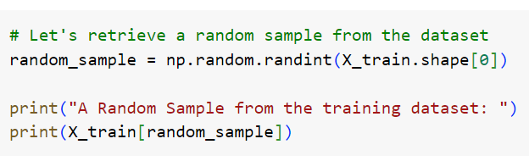
Padding - to ensure all the reviews are of 610 length

Slide 12
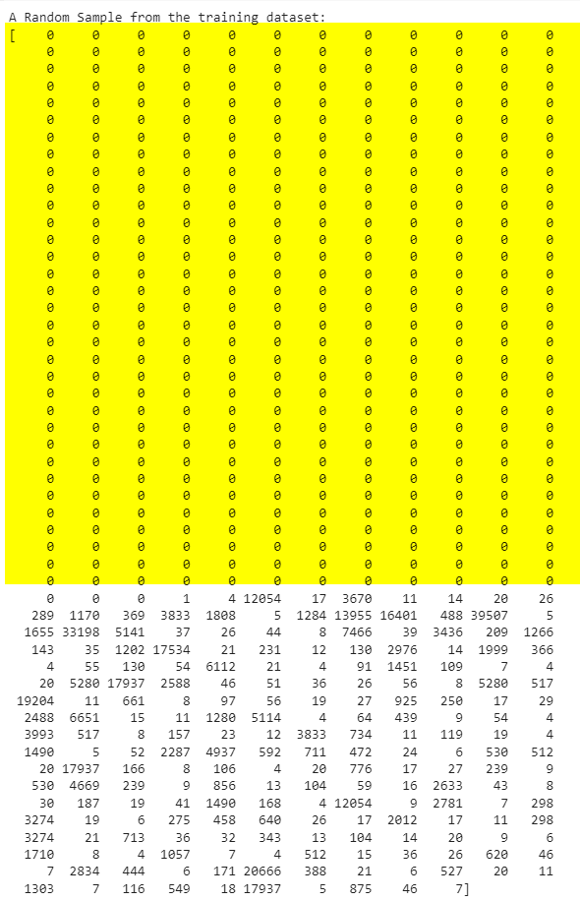
Padded Output

Slide 13
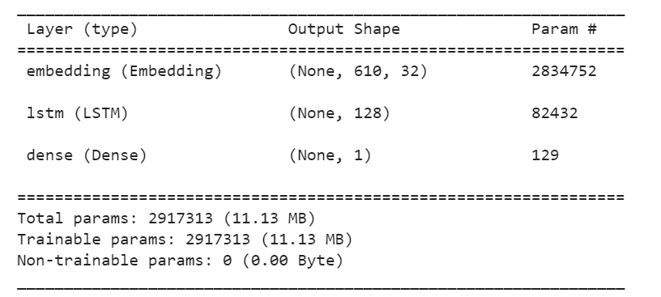
Baseline Model Creation
To serve as a baseline model we have created a simple LSTM based model to predict the movie review sentiment.
Here is the architecture of the baseline LSTM model:

Slide 14
Text Embeddings
Embeddings hold a special place in Natural Language Processing.
Embeddings represent a sequence of tokens into different representation by considering the words and the context in which they appear.
In this case, each review is of length 610 words or tokens.
Now, by considering the tokens context, let's represent each review as a vector of size 32.

Slide 15
Embedding Layer in Tensorflow
The 88586 - represents the total number of unique words in the training dataset.
EMBED_LEN - 32 for the baseline model.
MAX_LEN - each review is of length 610 tokens.

Slide 16
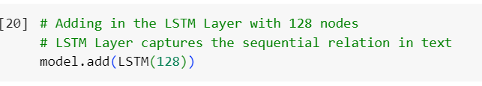
LSTM Layer
With LSTMs, the information flows through a mechanism known as cell states.
This way, LSTMs can selectively remember or forget things.
The information at a particular cell state has three different dependencies.
Ref.: https://www.analyticsvidhya.com/blog/2017/12/fundamentals-of-deep-learning-introduction-to-lstm/
Tensorflow LSTM: https://www.tensorflow.org/api_docs/python/tf/keras/layers/LSTM

Slide 17
Overall Baseline LSTM Model
The baseline LSTM model that we came up with is very simple.
It has the following layers:
First layer is an Embedding layer - which represents each token or word with its context data. Context data is typically the set of words within which the current word appears in.
Then we have an LSTM with 128 neurons. LSTM layers capture long range dependencies in capturing a sequential relationship between the input words.
Lastly, we have a Dense layer that has a single node to classify whether a given review is positive or negative.

Slide 18
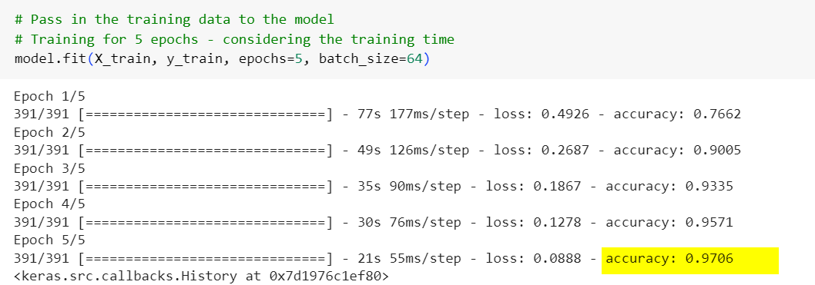
Model Training
We trained the baseline model for 5 epochs with a batch size of 64.

Slide 19
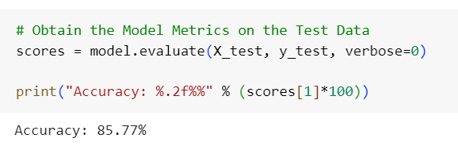
Test Set Accuracy
So far, we got a test set accuracy of 86% (approximately).
We will work on improving the test set accuracy by varying the number of LSTM layers and the embedding size.

Slide 20
Future Steps
Hyperparameter Tuning to reduce the gap between the accuracy obtained from train and test dataset, hence :
Optimizing the model performance
Preventing Overfitting or Underfitting
Enabling Model Generalization

Slide 21
Reference
https://www.tensorflow.org/api_docs/python/tf/keras/datasets/imdb/load_data
https://www.analyticsvidhya.com/blog/2017/12/fundamentals-of-deep-learning-introduction-to-lstm/
https://www.tensorflow.org/api_docs/python/tf/keras/layers/LSTM

Slide 22


